Slide 1
CIS 4930-001: Introduction to Augmented and Virtual Reality
The History of Augmented & Virtual Reality

Slide 2
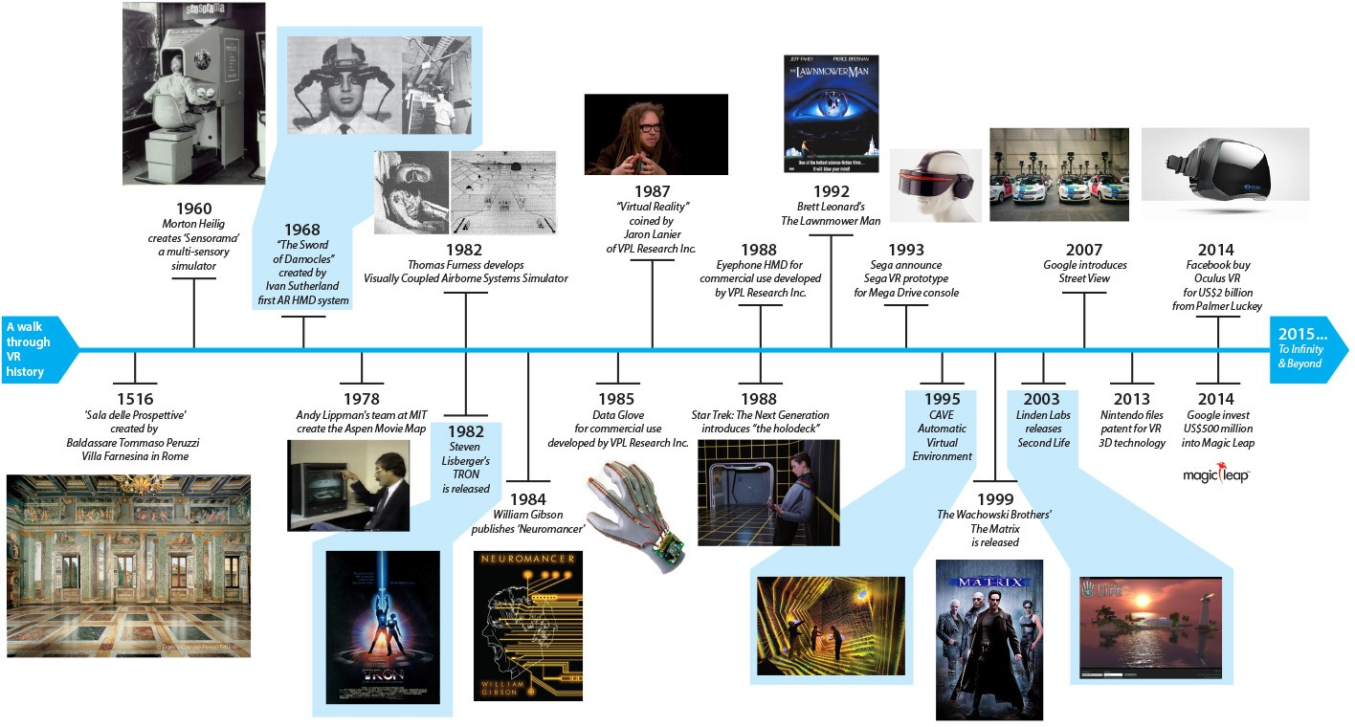
AR/VR History Timeline
https://immersivelifeblog.files.wordpress.com/2015/04/vr_history.jpg

Slide 3
When anything new comes along, everyone, like a child discovering the world thinks that they’ve invented it, but you scratch a little and you find a caveman scratching on a wall is creating virtual reality in a sense.
Morton Helig (Hammit 1993)

Slide 4
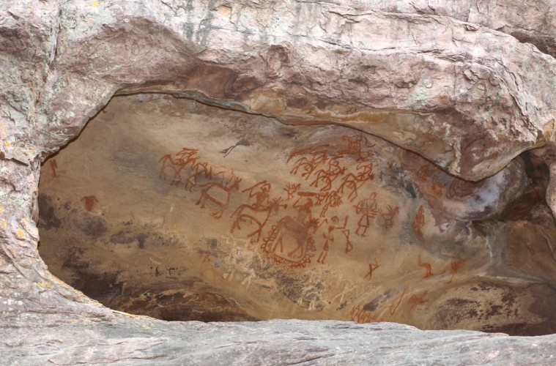
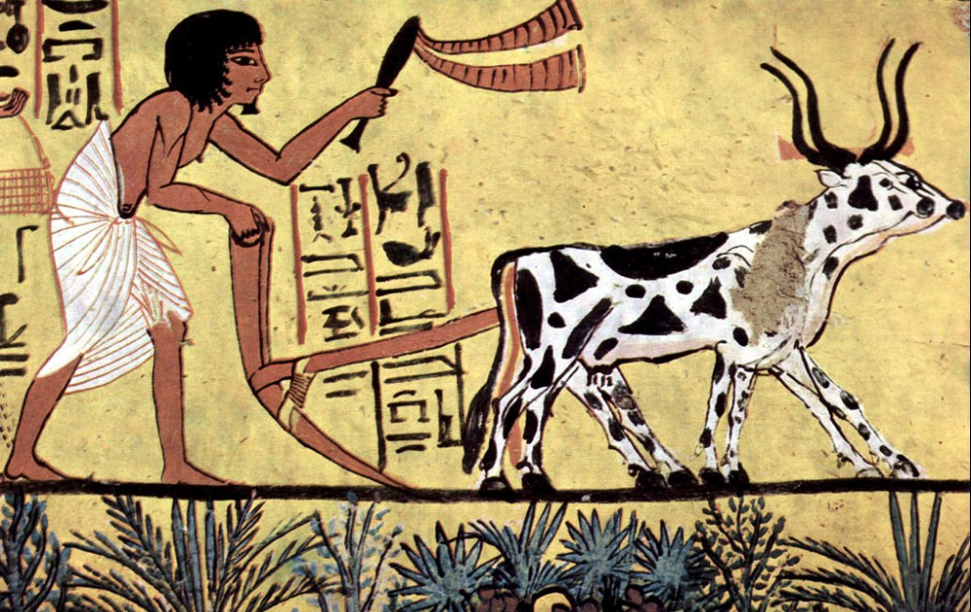
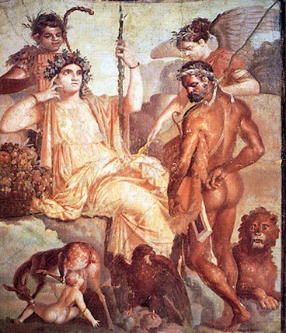
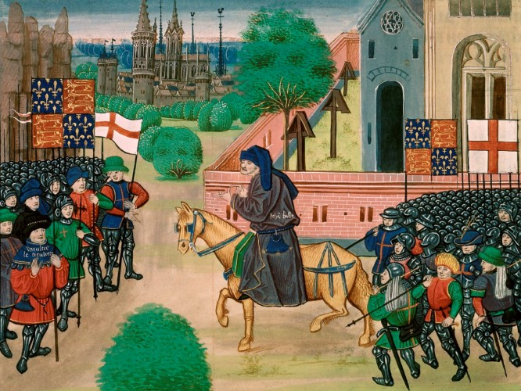
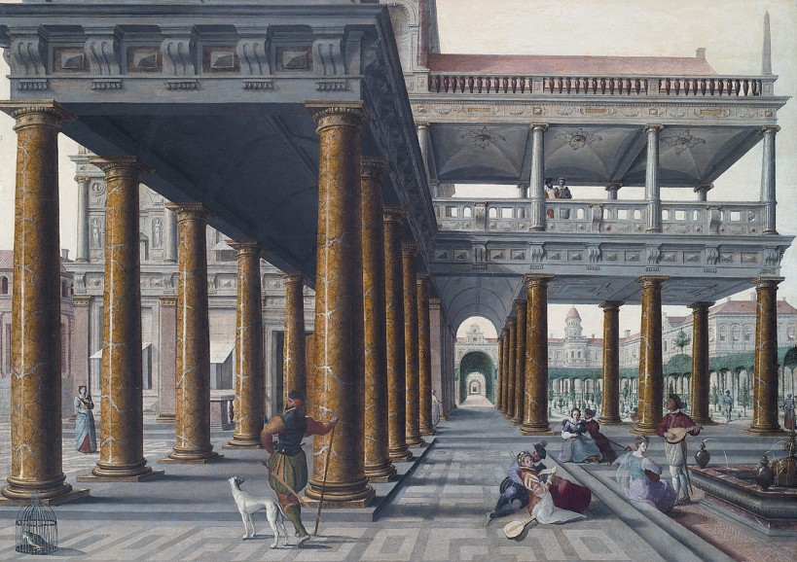
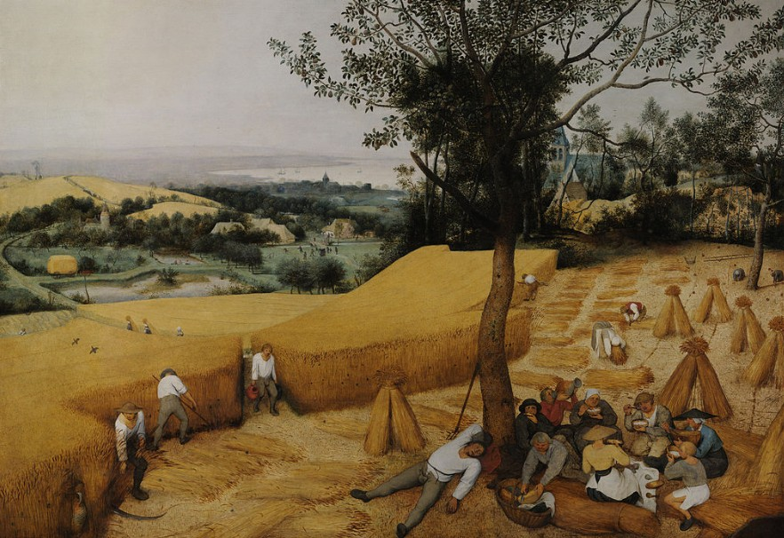
Early History (30,000 BC - )
The history of VR is rooted in human’s first attempts to reproduce the world around them

Slide 5
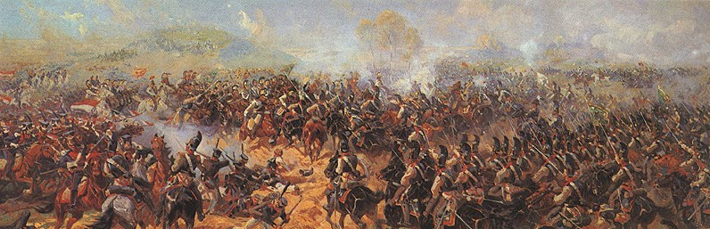
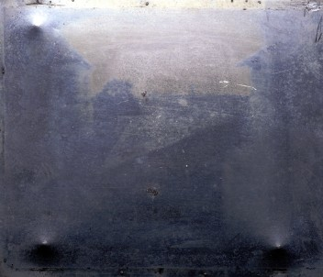
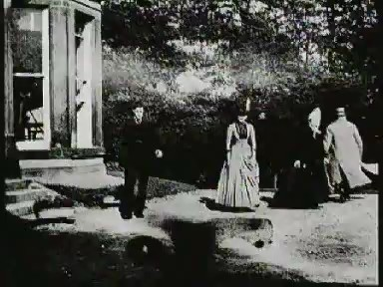
1800’s – Capturing Reality
Panoramas (1790s)
Immersive paintings
Photography (1820-30s)
Oldest surviving photo (Niépce, 1826)
Stereo imagery (1830s)
Wheatstone (1832)
Brewster (1851)
Movies (1870s)
Muybridge (1878)
Roundhay Garden Scene (1888)

Slide 6
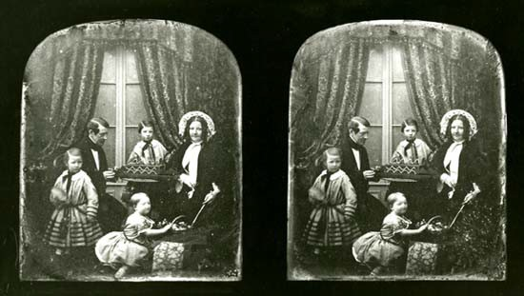
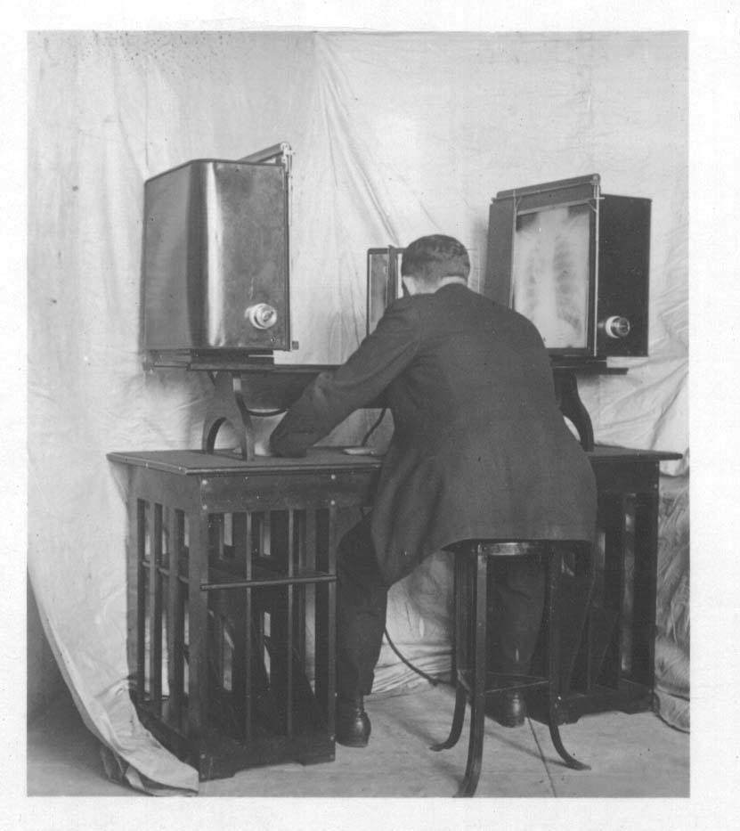
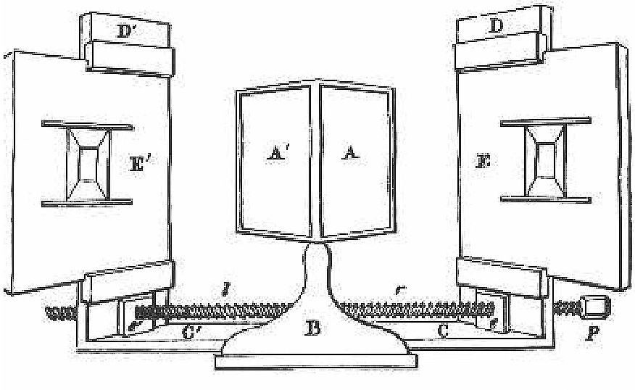
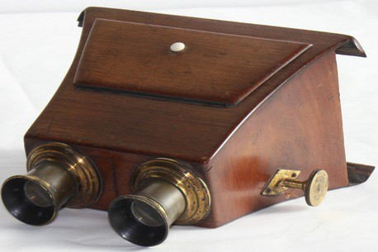
Stereo Viewers
Wheatstone Stereoscope (1832)
Brewster (1860)

Slide 7
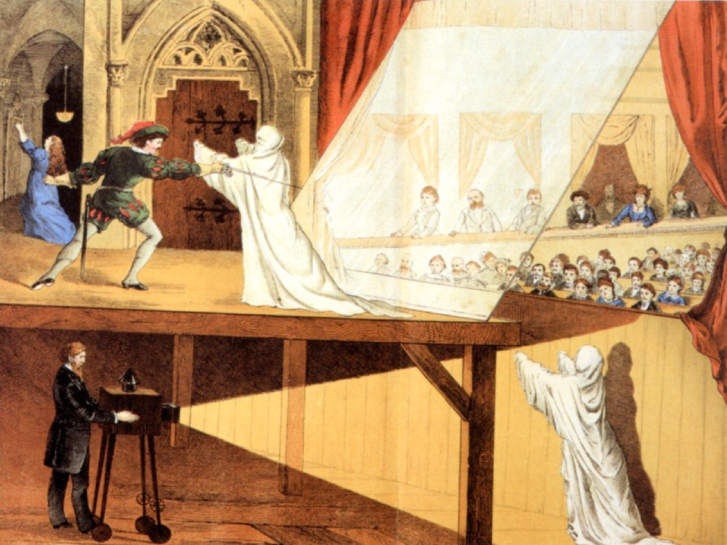
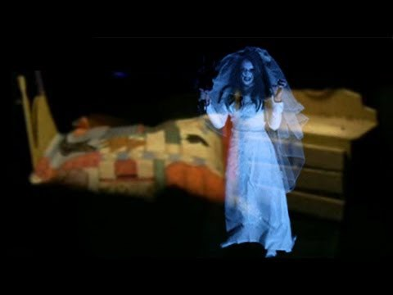
Pepper’s Ghost (1862)
Dates back to Giambattista della Porta (1584)

Slide 8

The Master Key (1901) – AR Glass
"It consists of this pair of spectacles. While you wear them every one you meet will be marked upon the forehead with a letter indicating his or her character. The good will bear the letter 'G,' the evil the letter 'E.' … Thus you may determine by a single look the true natures of all those you encounter.”
L. Frank Baum

Slide 9
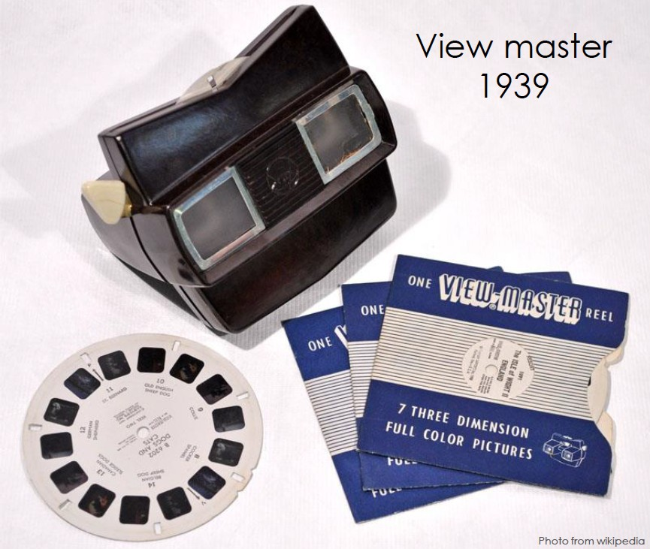
Viewmaster (1939)

Slide 10
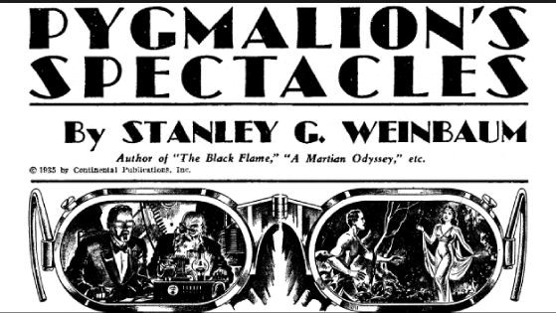
Pygmalion's Spectacles (1935)
Short Story by Stanley Weinbaum
Probably the first comprehensive VR model
Main character, Dan Burke, tries a pair of goggles that provide: "a movie that gives one sight and sound [...] taste, smell, and touch. [...] You are in the story, you speak to the shadows (characters) and they reply, and instead of being on a screen, the story is all about you, and you are in it."
Notes:
Pig-malion

Slide 11
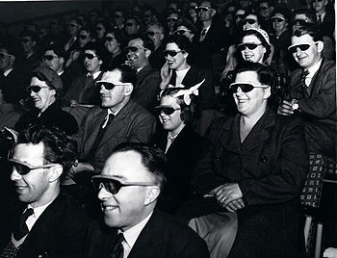
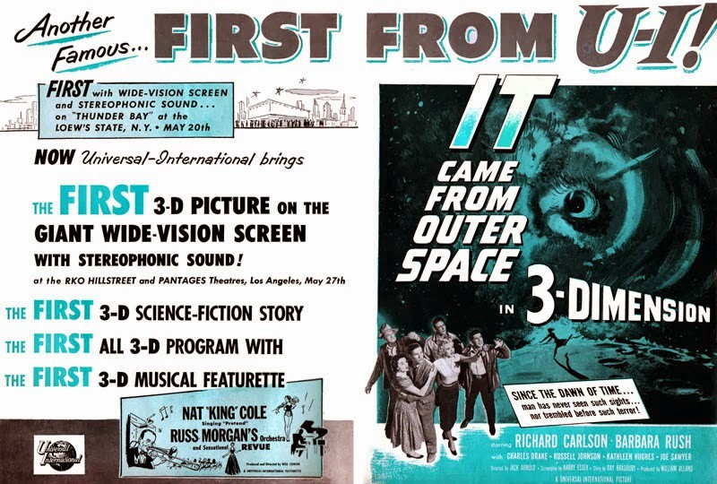
3D Cinema Golden Era (1950-60s)
Polarized 3D projection or anaglyph (red/blue)

Slide 12
Early 1950s – Cinerama (Fred Waller)
Movie screen big enough to give a 180° horizontal view.
Viewers feel like they´re in the scene
Required 3 cameras and 3 projectors (very much like IMAX or modern Powerwalls)

Slide 13
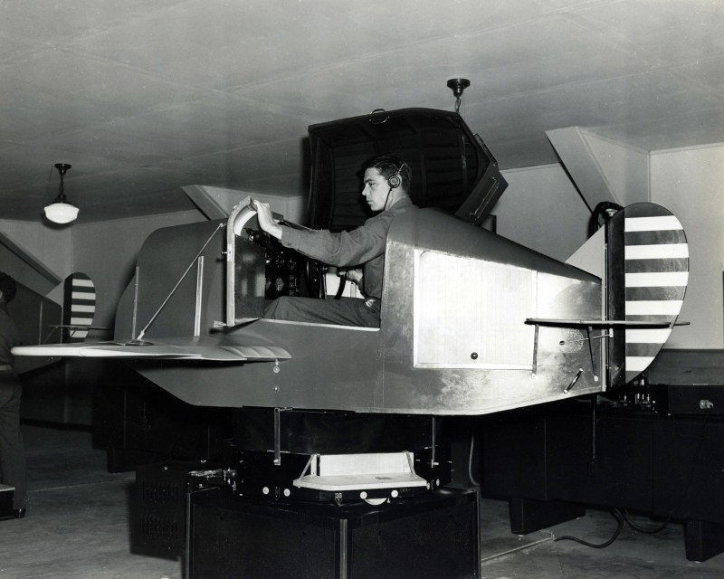
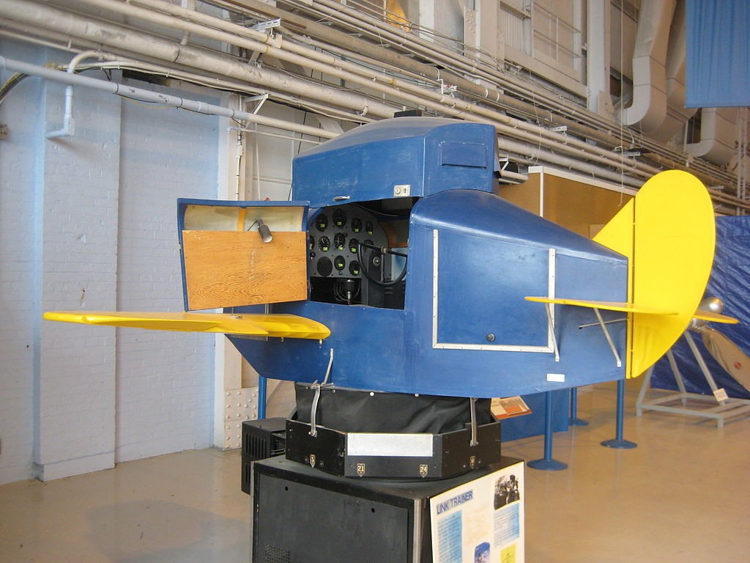
Link Trainer (1929 – 1950s)
Flight Simulator Training
Full six degree of freedom rotation
Force feedback and motion control
Simulated instruments
Modeling common flight conditions
Over 500,000 pilots trained

Slide 14
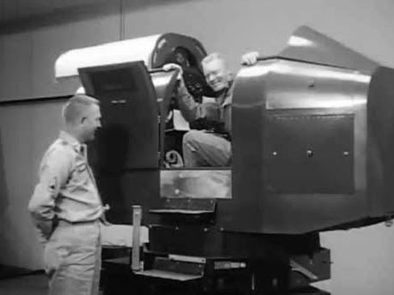
Link Trainer Video (1966)
https://youtu.be/MEKkVg9NqGM

Slide 15
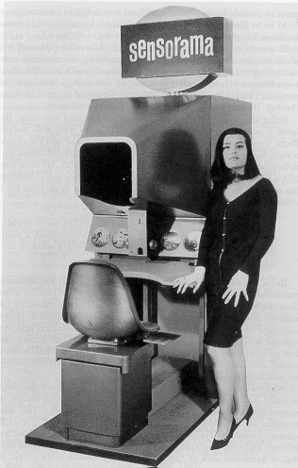
Sensorama (1955) - Morton Heilig
”… a virtual reality simulator with handlebars, binocular display, vibrating seat, stereophonic speakers, cold air blower, and a device close to the nose that would generate odors that fit the action in the film…”
Motorcycle ride on the streets of Manhattan!
Multi-sensory—Visuals, Sound, Wind, Vibration, and Smell
No financial support—commercial failure

Slide 16
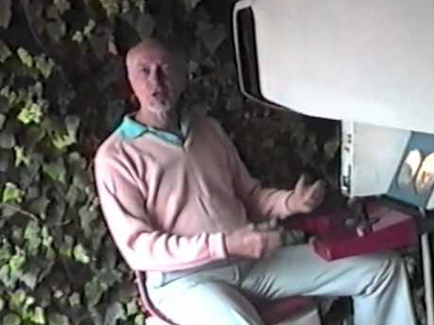
Sensorama Video
https://youtu.be/vSINEBZNCks

Slide 17
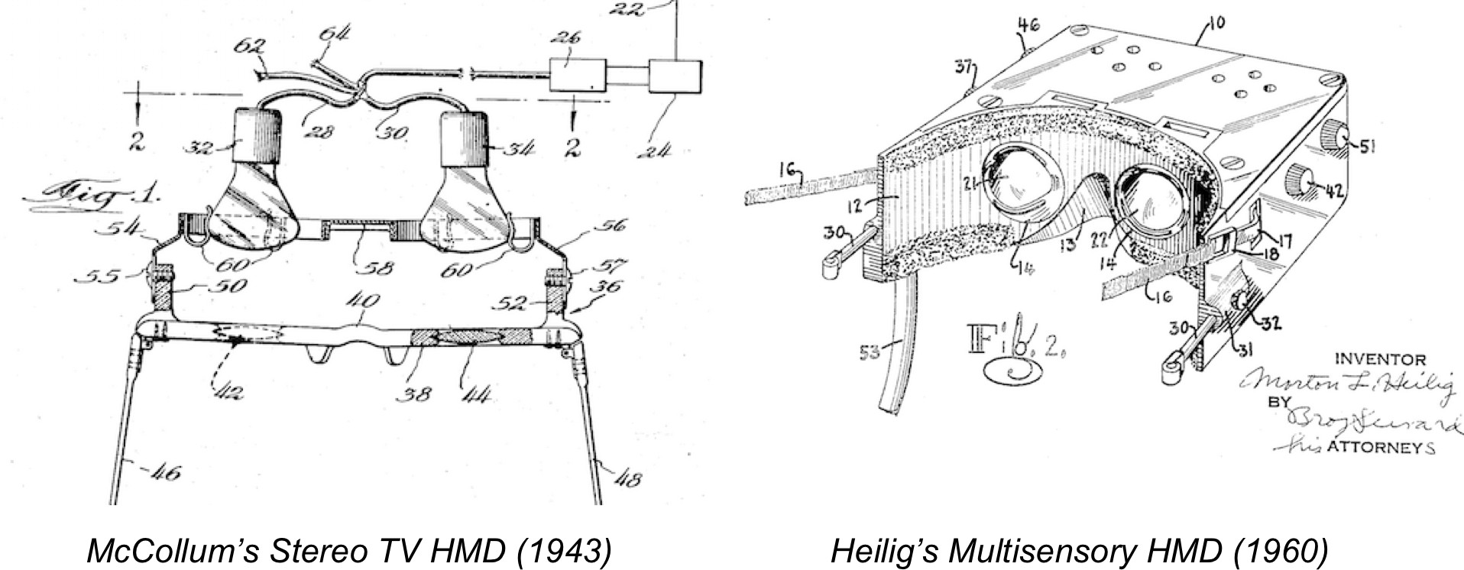
Early HMD Patents

Slide 18
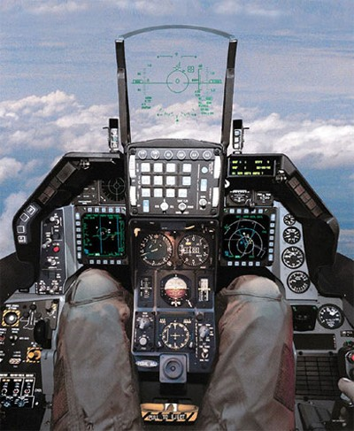
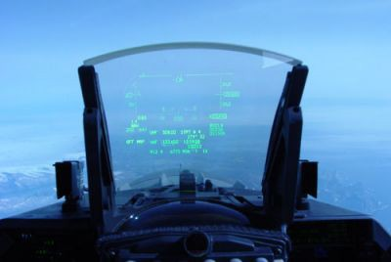
Early HUD (1958)
F16 – Head Up Display

Slide 19
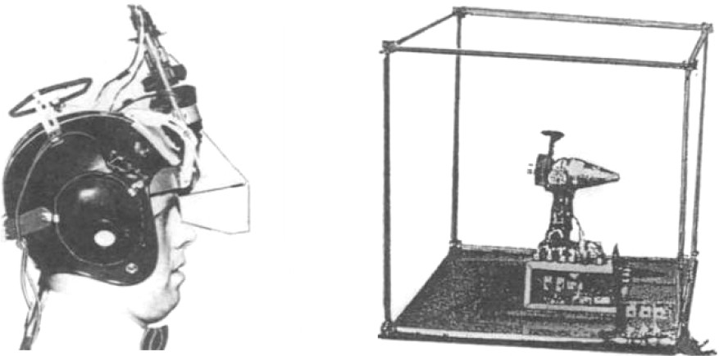
HMD (1961)
Philco Headsight– Remote Camera Viewing
Components – HMD, closed circuit television
Custom magnetic tracking for head orientation

Slide 20
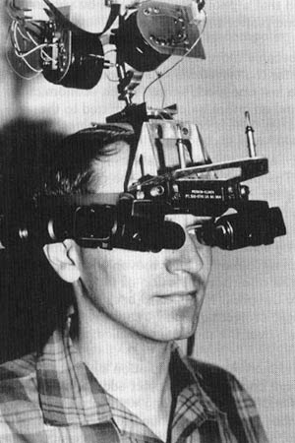
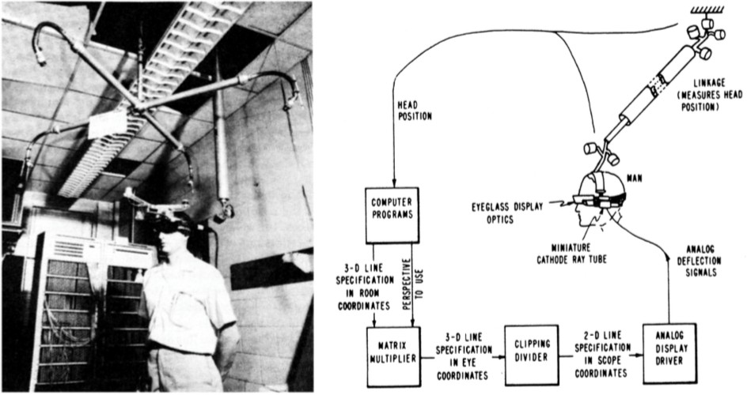
Ivan Sutherland’s Head-Mounted Display (1968)
See-through HMD
CRT based
Hidden-line geometry
Mechanical head tracking
Binocular, not stereo
40 degree of view

Slide 21
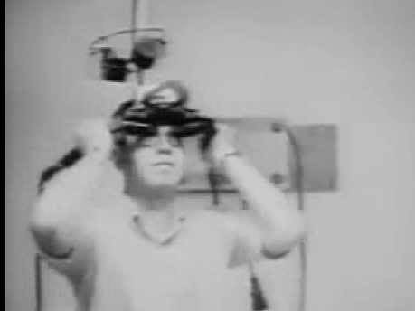
Sutherland Display
https://youtu.be/NtwZXGprxag

Slide 22
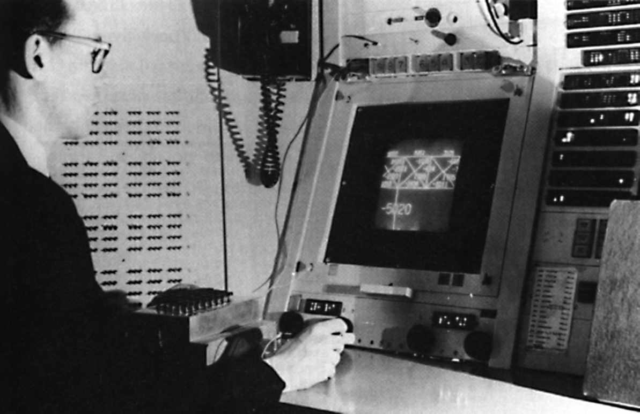
Ivan Sutherland Sketchpad (1963)
Sketchpad – first interactive graphics program

Slide 23
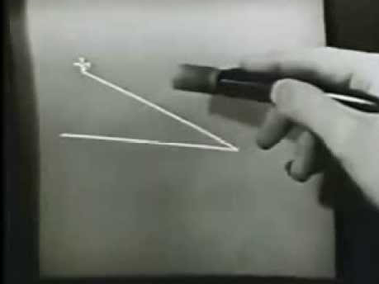
Ivan Sutherland Sketchpad Demo
https://youtu.be/YB3saviItTI

Slide 24
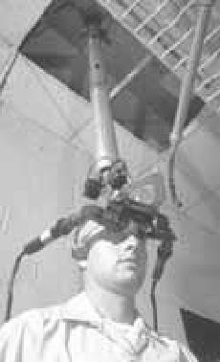
Ivan Sutherland Vision (1965)
About Data Visualization: “A display connected to a digital computer…is like a looking glass into a mathematical Wonderland.”
About Realism: ”A chair display in such a room would be good enough to sit in. Handcuffs displayed in such a room would be confining, and a bullet displayed in such a room would be fatal.”
About Reality: “There is no reason why the objects displayed by a computer have to follow ordinary rules of physical reality with which we are familiar.”

Slide 25
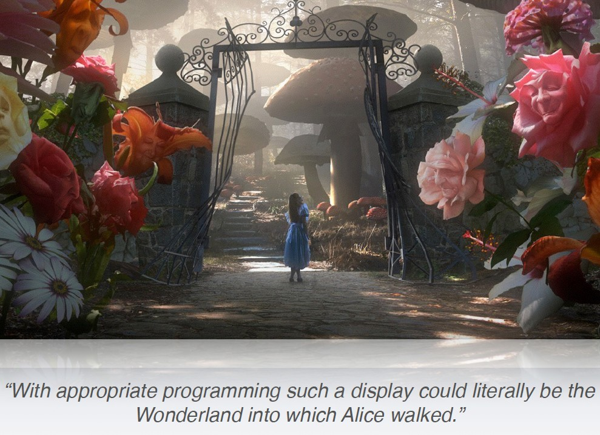
An Invisible Interface

Slide 26
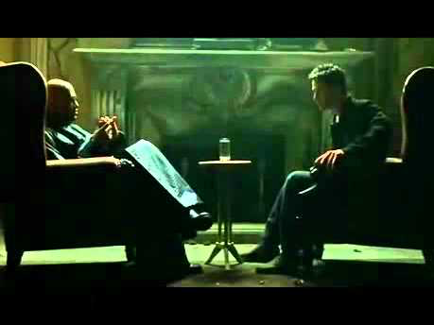
The Matrix: The Rabbit Hole
https://youtu.be/O4zICmyuNvs

Slide 27
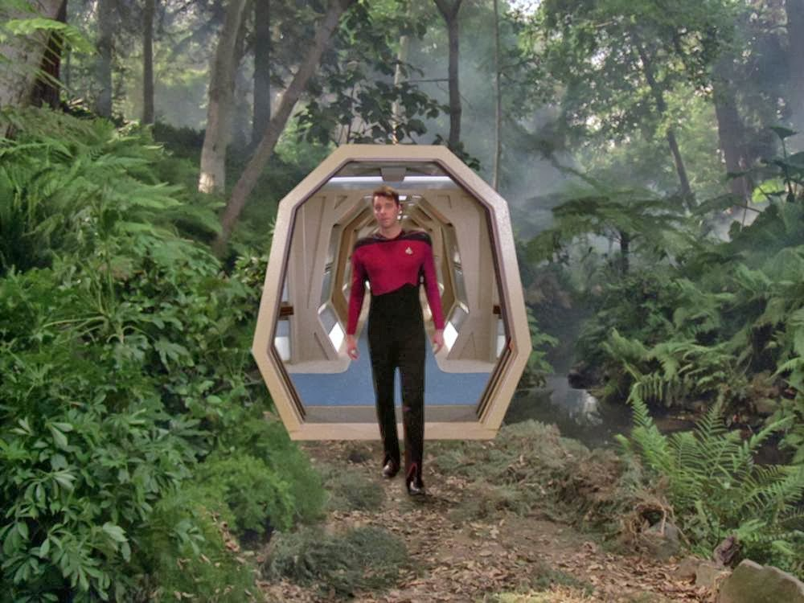
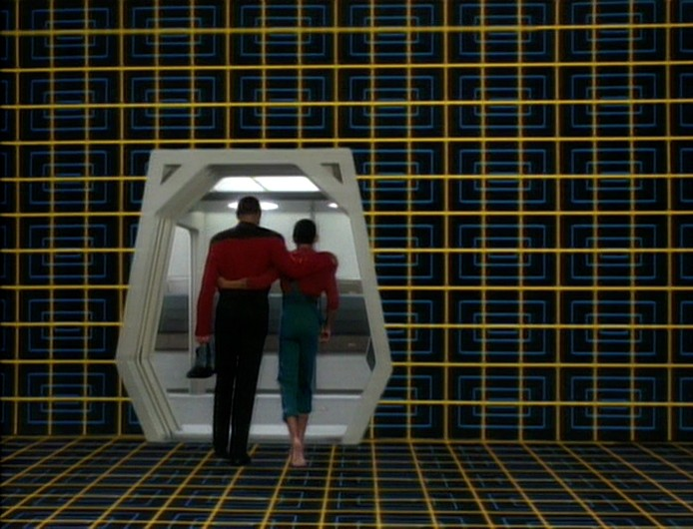
Holodeck (1974)
First shown in Star Trek: The Animated Series
Later appeared in Star Trek: The Next Generation

Slide 28
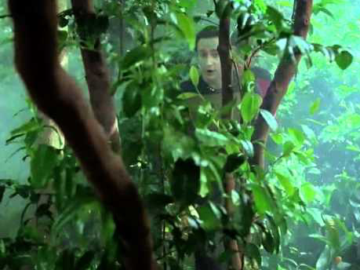
HoloDeck Video
https://youtu.be/oZwtVz7z0wM

Slide 29
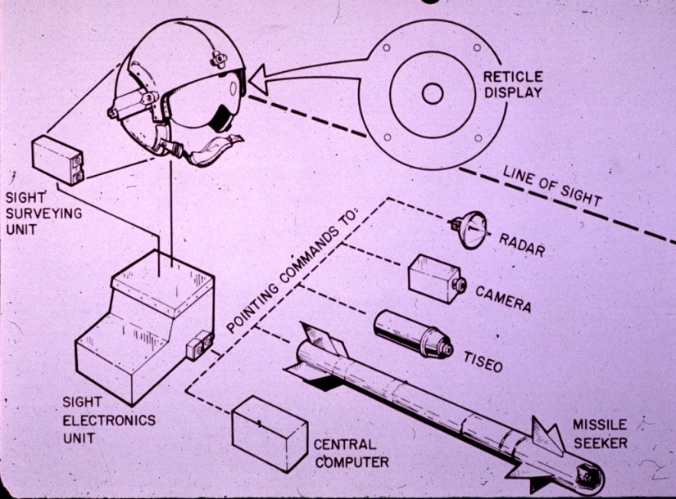
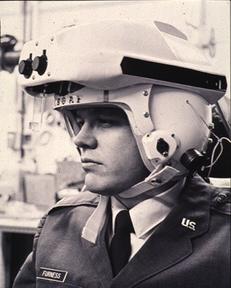
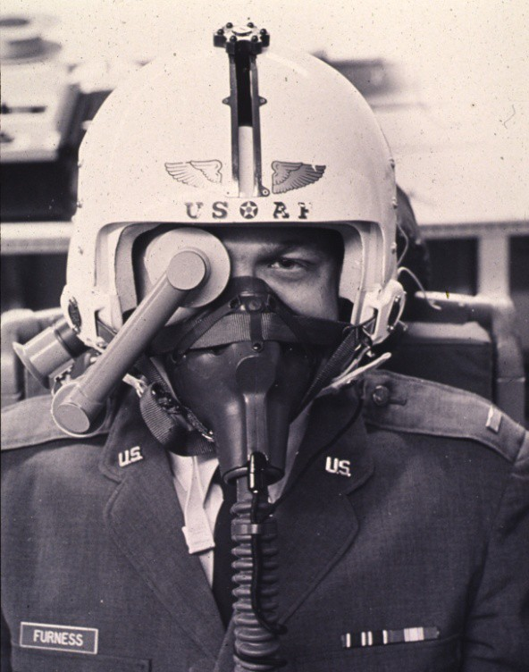
US Airforce HMDs
1960 - 70’s: US Air Force HMDs (T. Furness III)

Slide 30
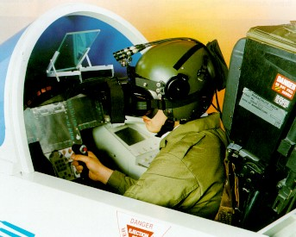
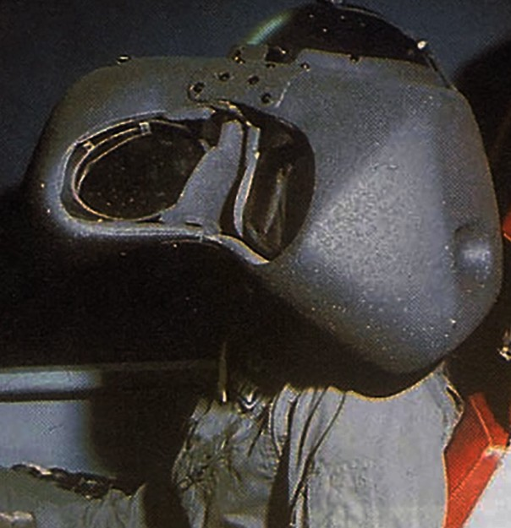
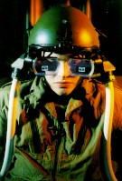
Super Cockpit (1965-80’s)
US Airforce Research Program
Wright Patterson Air Force Base
Tom Furness III
Multisensory
Visual, auditory, tactile
Head, eye, speech, and hand input
Addressing pilot information overload
Flight controls and tasks too complicated
Research only
big system, not safe for ejecting

Slide 31
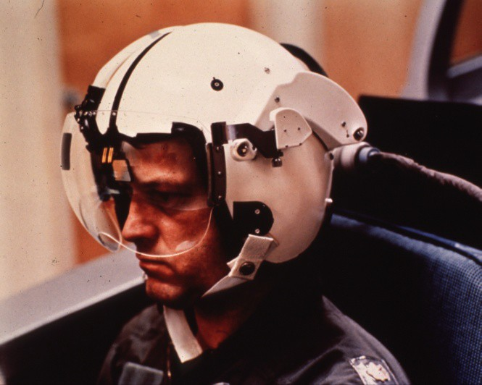
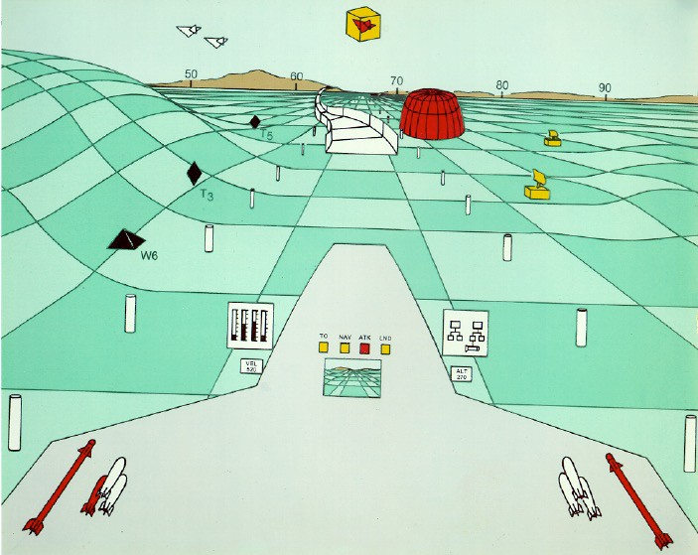
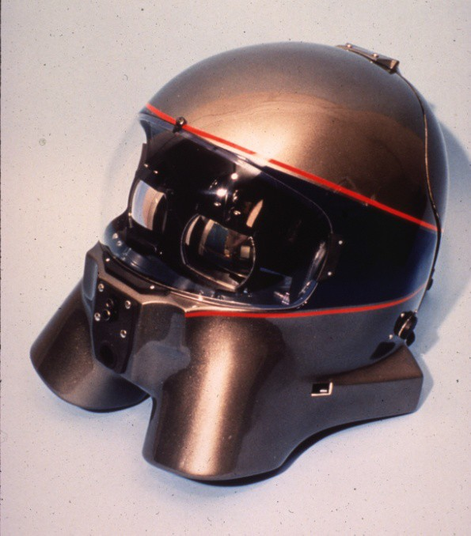
SuperCockpit Program
1970 - 80’s: US Air Force Super Cockpit (T. Furness III)

Slide 32
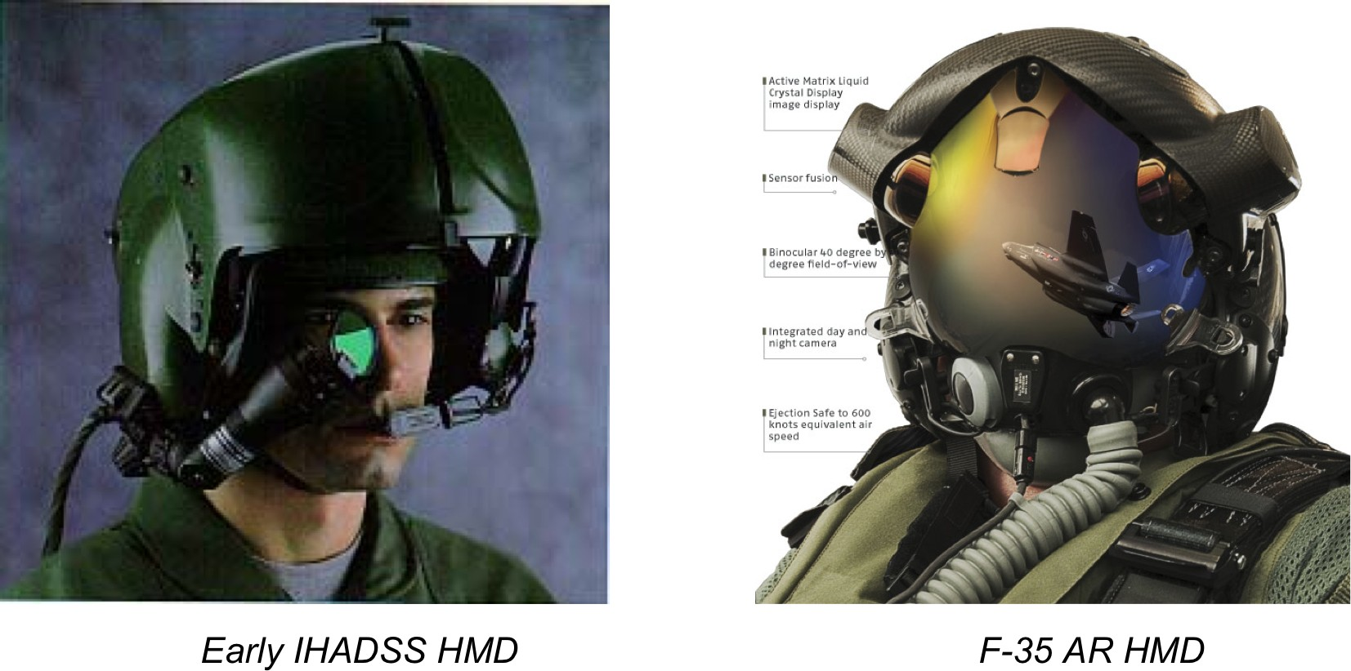
Modern Airforce HMDs
Honeywell Integrated Helmet and Display Sighting System (IHADSS) on AH-64 Apache attack helicopter in 1985

Slide 33

F35- HMD Demo (2014)
https://youtu.be/Ay6g66FbkmQ

Slide 34

StarWars (1977)
Use of 3D graphics and AR interfaces

Slide 35

Aspen Movie Map (1978)
Andrew Lippman, MIT
Car driven through Aspen
4 stop motion cameras
Pictures every 10 feet
Interactive playback
Played from laserdisc, touch screen
People able to navigation in any direction
Map interface
3D graphics overlay
Early version of Google StreetView

Slide 36

Aspen Movie Map Demo
https://youtu.be/X5Oj4S_x2Cc

Slide 37



VideoPlace (1975-80’s)
Myron Krueger
Graphics/gesture recognition
Real time interaction
VideoDesk
camera captures gestures
relays to remote collaborator
gestures control graphics
paint, draw, menu selection
Wrote Book – Artificial Reality 2

Slide 38

VideoPlace Demo
https://youtu.be/dqZyZrN3Pl0

Slide 39


LEEP Optics (1979)
Large Expanse, Extra Perspective optics
Developed by Eric Howlett
Lens design for extremely wide field of view
High resolution in center, lower resolution in periphery
90º direct FOV, 140º corneal FOV
Used as basis for most VR HMDs

Slide 40

LEEP Optics Design

Slide 41

Tron (1982)
• asdfa

Slide 42

Tron (1982)
https://youtu.be/VcyCWEsbsPU

Slide 43



The Data Glove (1981-82)
Precursor, Sayre Glove
Univ. of Illinois, 1977
Thomas Zimmerman (1982)
Fiber optic bend sensors
Detecting finger bending
Commercialized by VPL
Mattel PowerGlove (1989)

Slide 44

VPL DataGlove Demo
https://youtu.be/fs3AhNr5o6o

Slide 45



NASA VIEW/VIVED (1981-86)
Early HMD (McGreevy Humphries)
LCD “Watchman” displays
VIEW (Scott Fisher)
Polhemus tracker
LEEP-based HMD
3D audio (Convolvotron)
DataGlove gesture input
Simple graphics
1984 – NASA Ames Virtual Visual Environment (ViVED)
Dr. Michael McGreevy
For use for future astronauts
tactile input and feedback
Voice recognition
1985 – NASA Ames Virtual Interface Environment Workstation (VIEW)

Slide 46



Virtual Interface Environment Workstation
Motorbike helmet + LEEP

Slide 47




VPL Research (1985 – 1999)
First Commercial VR Company
Jaron Lanier, Jean-Jacques Grimaud
Provided complete systems
Displays, software, gloves, etc
DataGlove, EyePhone, AudioSphere
Jaron Lanier coined term “Virtual Reality”

Slide 48



Rise of Commercial VR Companies
W Industries/Virtuality (1985 - 97)
Location based entertainment
Virtuality VR Arcades
Division (1989 – 1998)
Turn key VR systems
Visual programming tools
Virtual i-O (1993 -1997)
Inexpensive gamer HMDs
Sense8 (1990 - 1998)
WorldToolKit, WorldUp
VR authoring tools

Slide 49

Virtuality (1991 UK) –Dactyl Nightmare
https://youtu.be/2Xj7qPEUEq0

Slide 50



The Virtual Retinal Display (1991)
Image scanned onto retina
Commercialized through Microvision
Nomad System - www.mvis.com
Lead to MagicLeap technology

Slide 51


Early Application
KARMA (91)
Feiner
Optical see-through HMD
Knowledge-based assistant for maintenance
Ultrasound trackers attached to assembly parts

Slide 52


Lawnmower Man (1992)

Slide 53

VR Learning in Lawnmower Man
https://youtu.be/zTrgHXNAs24

Slide 54

Lawnmower Man Inside VR
https://youtu.be/LUsWBCH8Ch8

Slide 55


CAVE (1992)
Projection VR system
3-6 wall stereo projection, viewpoint tracking
Developed at EVL, University of Illinois Chicago
Commercialized by Mechdyne Corporation (1996)
C. Cruz-Neira, D. J. Sandin, T. A. DeFanti, R. V. Kenyon and J. C. Hart. "The CAVE: Audio Visual Experience Automatic Virtual Environment", Communications of the ACM, vol. 35(6), 1992, pp. 64–72.

Slide 56

CAVE Demo Video
https://youtu.be/aKL0urEdtPU

Slide 57

Modern CAVE
https://youtu.be/kjAviW2alpA

Slide 58

Tangible interfaces and augmented surfaces – Basic principles
Virtual objects are projected on a surface
back projection
overhead projection
Physical objects are used as controls for virtual objects
Tracked on the surface
Virtual objects are registered to the physical objects
Physical embodiment of the user interface elements
Collaborative
Digital Desk. 1993

Slide 59



Tangible Interfaces and Augmented Surfaces (II)
Graspable interfaces, Bricks system (Fitzmaurice, et al. 1995) and Tangible interfaces, e.g. MetaDesk (Ullmer’97):
Back-projection, infrared-illumination computer vision tracking
Physical semantics, tangible handles for virtual interface elements
metaDesk. 1997

Slide 60

Tangible Interfaces and Augmented Surfaces (III)
Front projection
Marker-based tracking
Multiple projection surfaces
Tangible, physical interfaces
+ AR interaction with computing devices
Augmented surfaces, 1998
Rekimoto, et al. 1998

Slide 61



Mobile/Wearable Systems
1995 Navicam (Rekimoto)
Handheld AR
1997 Touring Machine (Feiner)
Backpack AR
GPS, see-through display

Slide 62


Desktop VR – 1995
Expensive - $150,000+
2 million polys/sec
VGA HMD – 30 Hz
Magnetic tracking

Slide 63




Virtual Reality was HOT! ... In mid-late ’90’s
US ARMY – spend close to $1B 1998 in VR research!

Slide 64

What Happened to VR?
https://youtu.be/tdAaU0CRHng

Slide 65

April 2007 Computer World
VR Voted 7th on list of 21 biggest technology flops

Slide 66


2007 - AR Reaches Mainstream
MIT Technology Review
March 2007
list of the 10 most exciting technologies
Economist
Dec 6th 2007
Reality, only better

Slide 67

Google Searches for AR

Slide 68
Augmented Reality
Mid-2000s to Today

Slide 69

2005 - Mobile Phone AR
Mobile Phones
camera
processor
display
AR on Mobile Phones
Simple graphics
Optimized computer vision
Collaborative Interaction

Slide 70

AR Advertising (HIT Lab NZ 2007)
Txt message to download AR application (200K)
See virtual content popping out of real paper advert
Tested May 2007 by Saatchi and Saatchi

Slide 71

Wellington Zoo Demo
https://youtu.be/edTjuXcce_c

Slide 72


2008 - Browser Based AR
Flash + camera + 3D graphics
ARToolKit ported to Flash
High impact
High marketing value
Large potential install base
1.6 Billion web users
Ease of development
Lots of developers, mature tools
Low cost of entry
Browser, web camera

Slide 73

Demo: GE Smart Grid
https://youtu.be/vJO_AZkCL9U

Slide 74


2008: Location Aware Phones
Motorola Droid
Nokia Navigator

Slide 75

2009 - Outdoor Information Overlay
Mobile phone based
Tag real world locations
GPS + Compass input
Overlay graphics on live video
Applications
Travel guide, Advertising, etc
Wikitude, Layar, etc..
iOS/Android, Public API released

Slide 76

Layar Demo (2009)
https://youtu.be/b64_16K2e08

Slide 77

2009 - AR in Magazines
Esquire Magazine
Dec 2009 issue
12 pages AR content
Many Others
Wired
Colors
Red Bull
Etc

Slide 78

Esquire Demo
https://youtu.be/LGwHQwgBzSI

Slide 79

Google Glass (2011)

Slide 80

Google Glass Demo
https://youtu.be/fNATuCkRWFE

Slide 81


Epson Moverio BT-200
Stereo see-through display ($700)
960 x 540 pixels, 23 degree FOV, 60Hz, 88g
Android Powered, separate controller
VGA camera, GPS, gyro, accelerometer

Slide 82


Hololens (2016)
Integrated system – Windows
Stereo see-through display
Depth sensing tracking
Voice and gesture interaction

Slide 83

View Through Hololens
https://youtu.be/2c9eiVyO6gM

Slide 84

Smart Glasses Available

Slide 85




Mobile Camera AR Apps (2015)
SnapChat - Lenses, World Lenses
Cinco de Mayo lens > 225 million views
Facebook - Camera Effects
Google – Word Lens/Translate

Slide 86



ARKit/ARcore (2017)
Visual Inertial Odometry (VIO) systems
Mobile phone pose tracked by
Camera (Visual), Accelerometer & Gyroscope (Inertial)
Features
Plane detection, lighting detection, hardware optimization
Links
https://developer.apple.com/arkit/
https://developers.google.com/ar/

Slide 87

ARKit Demos
https://youtu.be/6xDyVBsBtX8

Slide 88
Virtual Reality
Mid-2000s to Today

Slide 89
VR in the news
Yahoo! News, September 2007:
“Study: Kids' virtual worlds poised for growth spurt” (children’s online usage)
“Sony Delays 'Home' Virtual World for PS3”
“VirTra Systems Receives 24-system Simulator Order from Department of Homeland Security” (video-based training)
“It's a scream: Pizza patrons love coaster simulator” (motion base simulator)
“Patient conscious during surgery” (3D brain imaging)
“Digital education a virtual reality for children of Gen Net” (technology-based education)

Slide 90
VR in the news
ACM Tech News, September 2007:
“Folmer Believes a Virtual World Doesn't Have to Be a Visual One” (Second Life)
“IT Joins Library of Congress Partnership to Preserve Online Games and Virtual Worlds” (Second Life)
“Artists 'Draw on Air' to Create 3D Illustrations” (Brown Univ. CAVE)
“Virtual Worlds Open Up to Blind” (Active Worlds)
“The Promise of Parallel Universes” (World of Warcraft)
“Virtual Reality Will Enhance Real-World Experiences” (future AR)
“Is It Live or Is It AR?” (future AR)
(C) Doug Bowman, Virginia Tech, 2008
6

Slide 91

Photorealism – 1997 vs 2015

Slide 92


Photorealism
VFX Tech Demo

Slide 93


VR Second Wave (2010 - )
2012, Palmer Luckey (@ 17yrs old) made a prototype headset duct taped!
Aug 2012, John Carmack (doom & quake) improved it and showed at E3.
Aug 2012, game industry leaders showed strong support, Oculus is founded
Sep 2012, Kickstarter very successful (raised $2.4m)
2012-2014, over 60,000 headsets sold
March 2014, Facebook acquires Oculus for $2 billion.

Slide 94

Oculus Kickstarter
https://youtu.be/hxptk8P15TI?t=10

Slide 95



VR Searches on Google
Virtual Reality relative to global search

Slide 96

Desktop VR Today
Graphics Desktop
$1,500 USD
>4 Billion poly/sec
HMD (Vive Pro)
$800
1440x1600 (per eye)
90Hz refresh rate
110º FOV
Optical tracking
Room scale

Slide 97



Rise of Consumer HMDs
Oculus Rift
HTC/Vive
Sony Morpheus

Slide 98



HTC Vive
Room scale tracking
Gesture input devices

Slide 99
“Mobile” VR
Oculus Go
Qualcomm Snapdragon 821 processor
5.5-inch display
1280 x 1440 (per eye)
60-72Hz refresh rate
$200

Slide 100




Google Cardboard
Released 2014 (Google 20% project)
>5 million shipped/given away
Easy to use developer tools
+
=

Slide 101

Many Different Cardboard Viewers

Slide 102









Multiple Mobile VR Viewers Available

Slide 103
Conclusion
Virtual Reality has a long history
> 50 years of HMDs, simulators
Key elements for VR were in place by early 1990’s
Displays, tracking, input, graphics
Strong support from military, government, universities
First commercial wave failed in late 1990’s
Too expensive, bad user experience, poor technology, etc
We are now in second commercial wave
Better experience, affordable hardware
Large commercial investment, Significant installed user base
Will Virtual Reality be a commercial success this time?

